Slide 1
Azure devops pipeline
OW

Slide 2
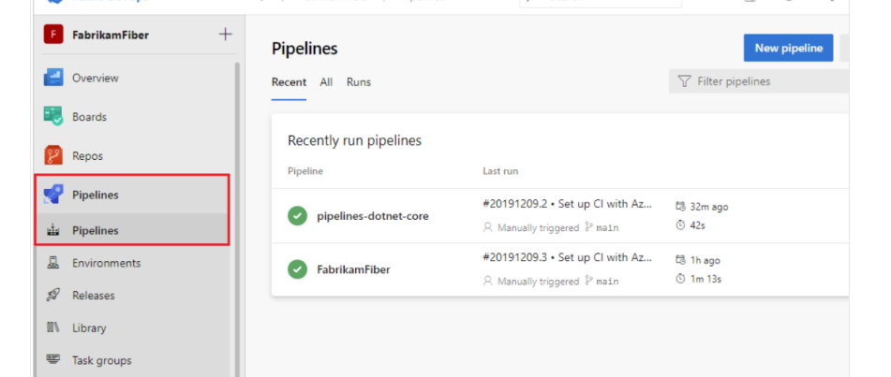
Intro
Azure Pipelines is like a handy cicd tool that takes care of building and testing your code projects for you.
It can handle different programming languages and project types, making sure everything works smoothly before sending it to where it needs to go.

Slide 3
CI CD
Continuous Integration (CI) is the practice used by development teams of automating, merging, and testing code. CI helps to catch bugs early in the development cycle, which makes them less expensive to fix.
- Increase code coverage - Build faster by splitting test and build runs - Automatically ensure you don't ship broken code - Run tests continually
Continuous Delivery (CD) is a process by which code is built, tested, and deployed to one or more test and production environments. Deploying and testing in multiple environments increases quality.

Slide 4
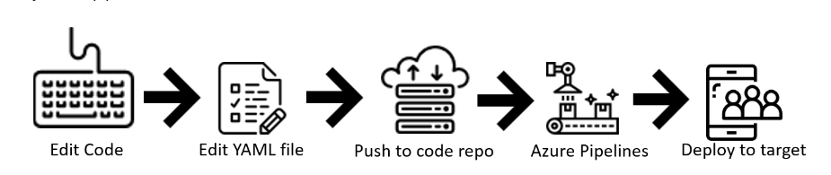
Define pipelines using YAML syntax
Azure Pipelines grows with your code, like a shadow. It copies how your code branches out for different tasks or versions. When you want to make changes, like adding new features or fixing bugs, these changes are checked by others in pull requests. There are also rules in place to make sure everything runs smoothly before it's put into action. This way, if anything goes wrong, you can track down the problem easily because everything is kept together, like pieces of a puzzle that fit perfectly.

Slide 5
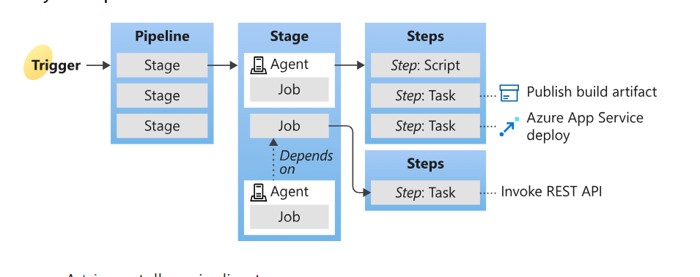
..

Slide 6
..
A trigger tells a pipeline to run. A trigger is something that's set up to tell the pipeline when to run. You can configure a pipeline to run upon a push to a repository, at scheduled times, or upon the completion of another build
A pipeline is made up of one or more stages. A pipeline can deploy to one or more environments. A pipeline defines the continuous integration and deployment process for your app. It's made up of one or more stages. It can be thought of as a workflow that defines how your test, build, and deployment steps are run.

Slide 7
..
A stage is a logical boundary in the pipeline. It can be used to mark separation of concerns (for example, Build, QA, and production). Each stage contains one or more jobs. When you define multiple stages in a pipeline, by default, they run one after the other. You can specify the conditions for when a stage runs.
A stage contains one or more jobs. Each job runs on an agent. A job represents an execution boundary of a set of steps. All of the steps run together on the same agent. Jobs are most useful when you want to run a series of steps in different environments

Slide 8
..
A step is the smallest building block of a pipeline. For example, a pipeline might consist of build and test steps. A step can either be a script or a task. A task is simply a precreated script offered as a convenience to you.
A trigger is something that's set up to tell the pipeline when to run. You can configure a pipeline to run upon a push to a repository, at scheduled times, or upon the completion of another build

Slide 9
..
The Library includes secure files and variable groups. Secure files are a way to store files and share them across pipelines.
For example, you may want to reference the same file for different pipelines. In that case, you can save the file within Library and use it when you need it. Variable groups store values and secrets that you might want to be passed into a YAML pipeline or make available across multiple pipelines.

Slide 10
..
trigger:
- main
pool:
vmImage: 'ubuntu-latest'
steps:
- task: Maven@4
inputs:
mavenPomFile: 'pom.xml'
mavenOptions: '-Xmx3072m'
javaHomeOption: 'JDKVersion'
jdkVersionOption: '1.11'
jdkArchitectureOption: 'x64'
publishJUnitResults: false
testResultsFiles: '**/surefire-reports/TEST-*.xml'
goals: 'package'

Slide 11
..
This pipeline runs whenever your team pushes a change to the main branch of your repo or creates a pull request.
It runs on a Microsoft-hosted Linux machine. The pipeline process has a single step, which is to run the Maven task
A task is a pre-packaged script. You can use tasks for building, testing, publishing, or deploying your app. For Java, the Maven task we used handles testing and publishing results, however, you can use a task to publish code coverage results too.

Slide 12
..Multiple platform: Strategy and matrix
strategy:
matrix:
linux:
imageName: "ubuntu-latest"
mac:
imageName: "macOS-latest"
windows:
imageName: "windows-latest"
maxParallel: 3
pool:
vmImage: $(imageName)

Slide 13
Job
jobs:
- job: Work
steps:
- script: echo Hello, world!
displayName: 'Run a one-line script'
# This malformed command causes the job to fail
# Only run this command if the succeed variable is set to false
- script: git clone malformed input
condition: eq(${{ parameters.succeed }}, false)

Slide 14
Job handler
- job: ErrorHandler
dependsOn: Work
condition: failed()
steps:
- bash: |
az boards work-item create \
--title "Build $(build.buildNumber) failed" \
--type bug \
--org $(System.TeamFoundationCollectionUri) \
--project $(System.TeamProject)
env:
AZURE_DEVOPS_EXT_PAT: $(System.AccessToken)
displayName: 'Create work item on failure'

